Slide 1
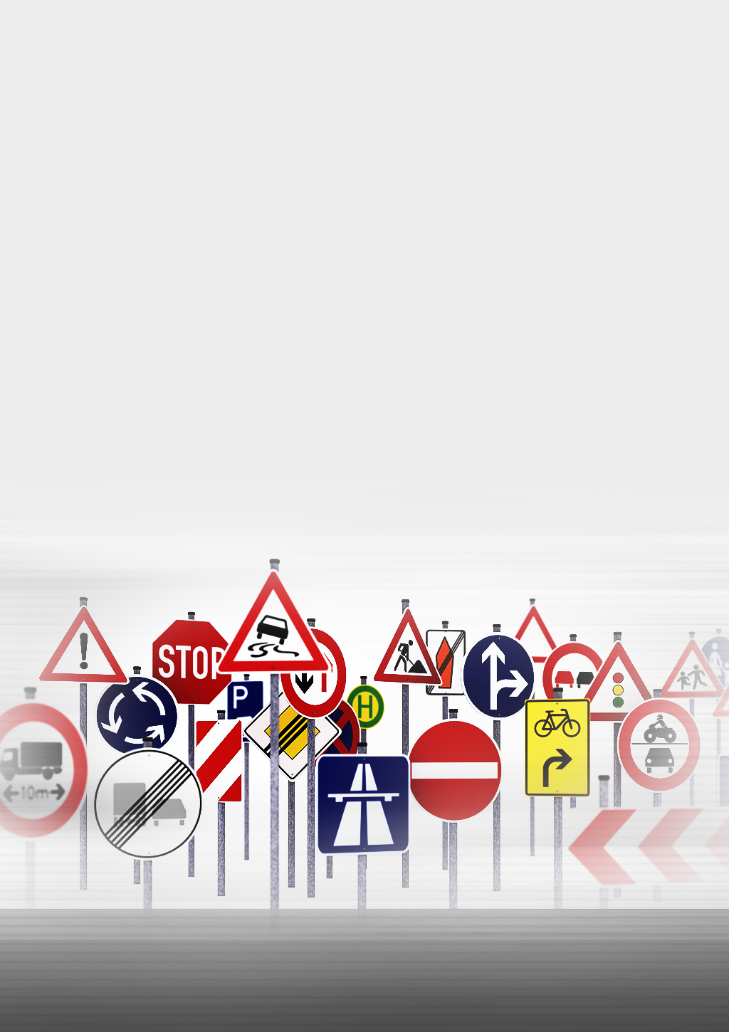
TRAFFIC SIGNS RECONATION

Slide 2
There are several different types of traffic signs like speed limits, no entry, traffic signals, turn left or right, children crossing, no passing of heavy vehicles, etc. Traffic signs classification is the process of identifying which class a traffic sign belongs to.
problem statement:

Slide 3
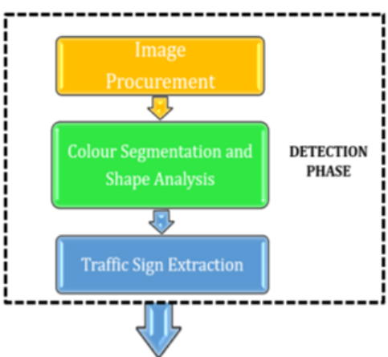
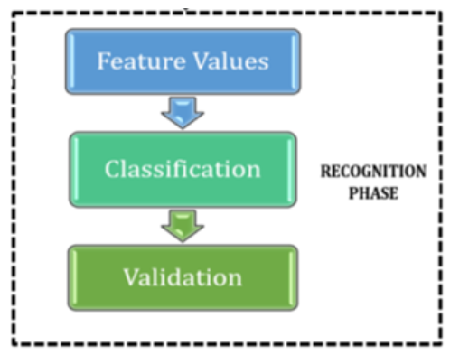
we will build a convolutional neural network model that can classify traffic signs present in the image into different categories.
DESIGN:

Slide 4
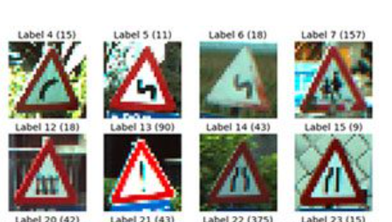
Dataset
The dataset initially consisted of more than 50,000 images in total which has been divided into 43 classes. These classes represent the different types of traffic signs. The dataset has two folders: a train folder that contains photos for each class and a test folder that will be used to evaluate our model.
Our traffic sign dataset:

Slide 5
Dataset:
Data Set Summary:
value | Data summary
34799 | Total training Examples
4410 | Total validation Examples
12630 | Total Testing Examples
(30,30,3) | Image shape
43 | Total classes

Slide 6
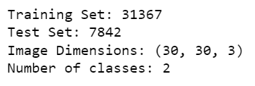
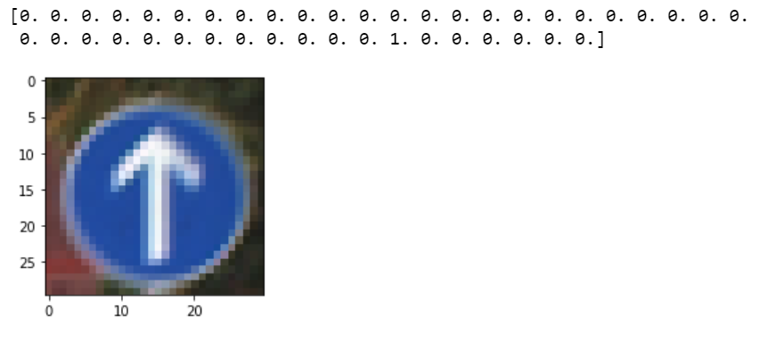
Dataset:
number of images per class
Visualize 1st Image in Training Set

Slide 7
Feature Engineering Converting categorical features into numerical features. Models I used convolutional neural network. Model Evaluation and Selection: we trained the model using model.fit after constructing the model architecture (). We experimented with 32 and 64-batch sizes. When the batch size was set to 64 Our model performed better. And the precision remained constant after 15 epochs.
Algorithm:

Slide 8
1- Numpy and Pandas for data manipulation 2- Scikit-learn for modeling 3- Matplotlib and Seaborn for plotting 4- Keras 5- Tkinter :it is the standard GUI library for Python
Tools:

Slide 9
This project presented a convolutional neural network implementation used for traffic signs classification. The applied methodology has shown significant result with an average validation accuracy of 96% which means that the model has been selected correctly
Result:

